Slide 1

Data Structures
Unit-1
T.Anil kumar
Assistant professor,
Dept. of CSE,
RGUKT IIIT Srikakulam

Slide 2
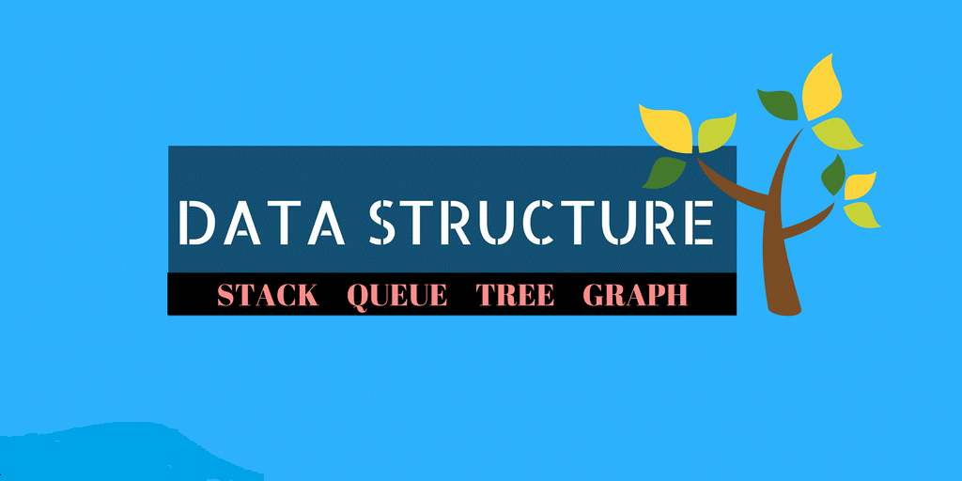

Slide 3
Agenda
What is data?
What is Data Structure?
Why we need?
Classification
Operations
Applications

Slide 4
What is Data?
It is a way of storing and manipulating data in organized form so that it can be used efficiently.
We can also define it as a mathematical or logical model of a particular organization of data items.
Data is a real fact that we collect from existing world/scenario.
It refers to a value or set of values.

Slide 5
Why we need Data Structures
Computer is an electronic machine which is used for data processing and manipulation.
In order to make computer work we need to know :
Representation of data in computer
Accessing of data
How to solve problem step by step.
For doing this task we use DATA STRUCTURES

Slide 6
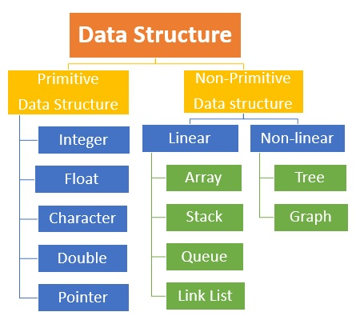
Classification of Data Structure

Slide 7
Primitive Data Structures
These are basic data structures and are directly operated upon by machine instructions.
All primitive data types are primitive data structures.
Integers , floats, characters are some of the examples .
Integer : A data type which allows all values without fraction.
Float :A data type which is used for storing fractional numbers.
Character :A data type used for character values.

Slide 8
Non-Primitive Data Structures
Derived from primitive data structures.
Emphasize on structuring of a group of homogenous or heterogeneous data items.
Examples are Array , Lists , Files etc.
Array : Fixed-size sequenced collection of elements of same data type.
Lists : An ordered set containing variable number of elements.
File : A collection of logically related information.
Non-primitive again classified into linear and non-linear.

Slide 9
Linear Data Structures
A data structure is said to be linear ,if its elements are arranged in linear fashion
It follows the property of adjacency.
There are to ways to represent a linear data structure in memory
Static memory allocation
Dynamic memory allocation
Examples of Linear Data Structure are Stacks , Queues , Linked List.

Slide 10
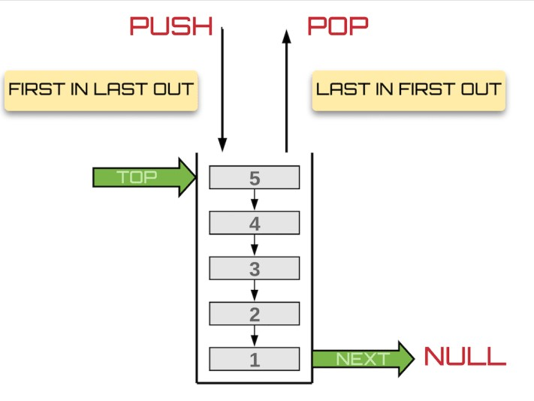
STACKS
A data structure which follows the principle either First In Last Out or Last In First Out.
Operations that can be performed on stacks are Push ,Pop , Peek

Slide 11
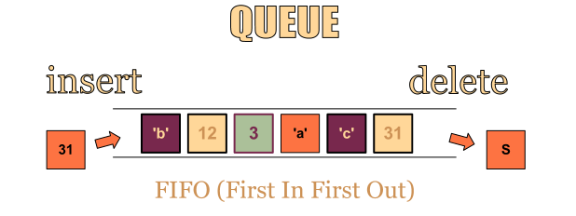
QUEUES
A Data Structure which follows the principle either First In First Out or Last In Last Out
Operations that can be performed on queues are : Insertion from REAR END and Deletion from FRONT END
Types of Queues : 1.Dequeue
2.Circular Queue
3.Priority Queue
Rear End
Front End

Slide 12
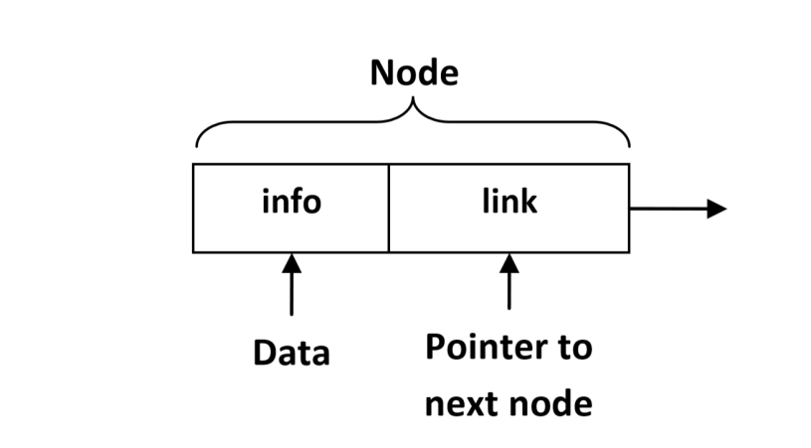
Linked List
A non-sequential collection of data items.
For every data item in the linked list there is an associated pointer that would give the memory allocation of the next data item.
The data items are not in consecutive
Types of Linked List :
Single Linked List
Circular Linked List
Double Linked List
Circular Double Linked List

Slide 13
Non-Linear Data Structures
A Data Structure in which the data items are not arranged in a sequence.
Examples of Non-Linear Data Structures are : Trees and Graphs

Slide 14
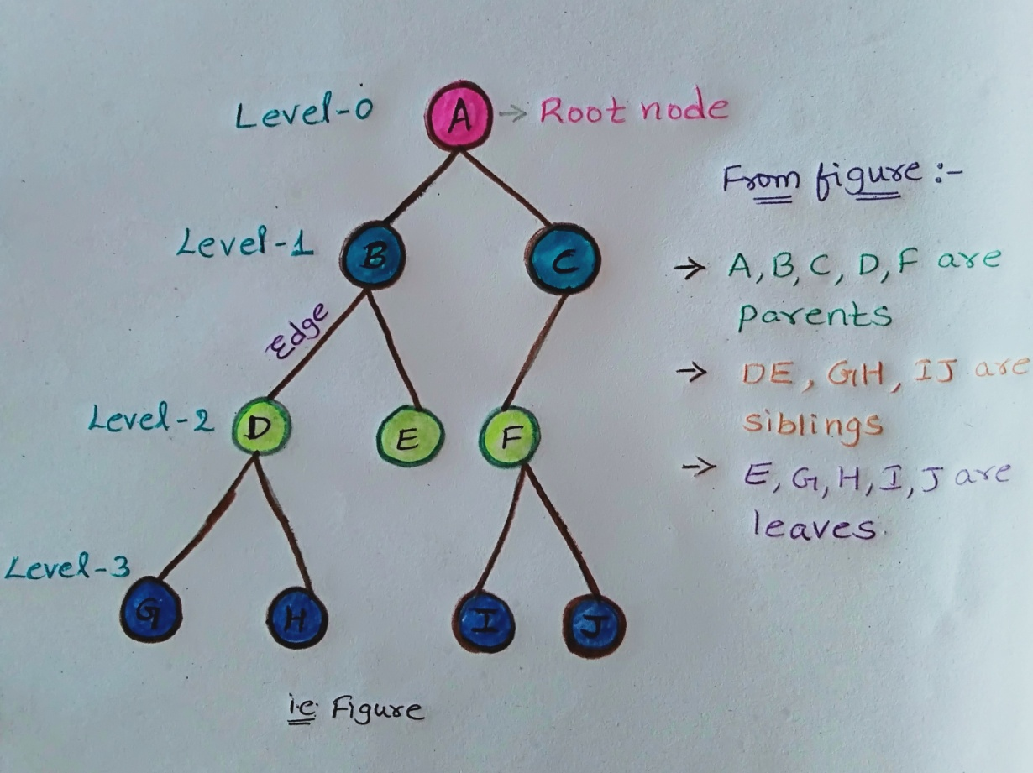
TREES
A non-linear data structure with collection of one or more nodes among all the nodes, one is root node.
Follows hierarchical order.
Also known as Inverted Tree.

Slide 15
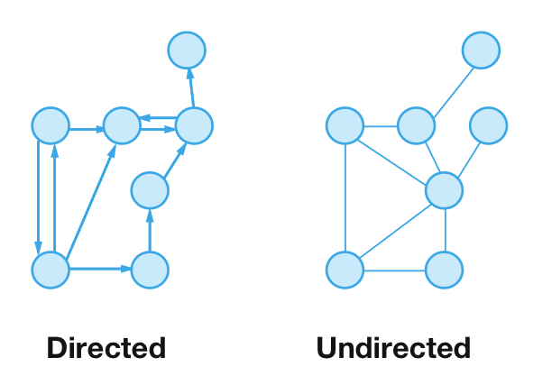
GRAPHS
A collection of nodes(information) and connecting edges(logical relation) between nodes.
Graphs have many types :
Directed Graph
Undirected Graph
Mixed Graph
Null Graph
Simple Graph
Multi Graph
Weighted Graph

Slide 16
Operation on Data Structures
Creation : It results in reserving memory for program elements.malloc() function of ‘C’ is used to create.
Deletion : It destroys memory allocated for data structure.free() function of ‘C’ is used to delete.
Search : It finds the presence of desired data item in the list of data elements.
Sorting : A process of arranging all data items in a particular order either ascending or descending order.
Traversing : A process of visiting each and every node in a systematic manner.

Slide 17
Applications of Data Structures
Applications of Arrays
To implement Searching and Sorting Algorithms
Matrix Multiplication
Applications of Stack
Recursion
Reversing Characters
Expression Evaluations
Servicing Hardware Interrupts
Applications of Queues
CPU Scheduling
Device Management

Slide 18
Continued……
Applications of Linked List
Implementation of Stacks and Queues
Implementation of Graphs
Maintaining directory of names
Applications of Trees
File System
Syntax Trees(Used in Compilers)
Trie(Used to implement a dictionaries with prefix lookup
Suffix Tree(For quick pattern searching)
Applications of Graphs
Electronic Circuits
Computer Networks
Databases
Transportation Network

Slide 19
LINKED LISTS
Note: Please check the class notes for the algorithms.

Slide 20
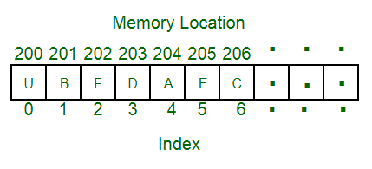
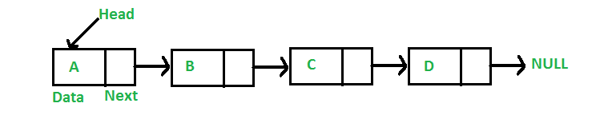
Arrays vs linked lists

Slide 21
ARRAYS :
Linear Data structures
Static allocation of memory and stores homogenous data
Insertions and Deletions are inefficient and modifications are easy
Random access of elements
LINKED LISTS:
Both linear(for accessing) and non linear (storing).
Dynamic allocation and have pointers to next node.
Insertions and Deletions are efficient and complex.
No random access of elements.

Slide 22
Some other differences
ASPECT | ARRAY | LINKED LIST
Searching | Binary search and Linear search | Only linear search
Usage | Array is not used as a stack or queue | Once linked list is defined the we can use it as arrays , stacks , queues ,Singly linked list etc.
Retrieval | It take time complexity of inserting or deleting of O(n) | It take It take time complexity of inserting or deleting of O(1)
Memory consumption | Least memory consumption | More memory consumption(extra memory for pointers)

Slide 23
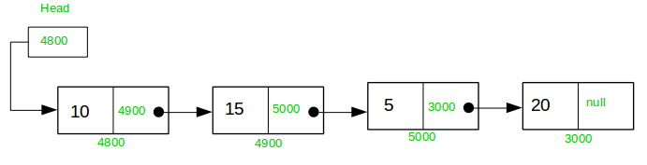
Single linked lists
A linked list, in simple terms, is a linear collection of data elements(nodes).
A data structure that removes the restrictions on the maximum number of elements and the storage condition to write efficient programs.
Linked list is a data structure that is free from the aforementioned restrictions.
Elements in a linked list can be accessed only in a sequential manner.

Slide 24
Insertion
We can perform any kind of operation in any linked list like insertion, deletion , search etc.,
Insertion at the start of the list
Insertion at the end of the list
Insertion in the middle of the list

Slide 25
Insertion at the starting
Steps:
Create a Node
Set the node data Values
Connect the pointers

Slide 26


Insertion Description
head
48
17
142
//
Follow the previous steps and we get
Step 1
Step 2
Step 3
head
93

Slide 27
Insertion at the end
Steps:
Create a Node
Set the node data Values
Connect the pointers

Slide 28



Insertion Description
head
48
17
142
//
Follow the previous steps and we get
Step 1
Step 2
Step 3

Slide 29
Insertion in the middle
Steps:
Create a Node
Set the node data Values
Break pointer connection
Re-connect the pointers

Slide 30




Insertion Description
Step 1
Step 2
Step 3
Step 4

Slide 31
Deletion
Deleting from the start of the list
Deleting from the end of the list
Deleting from the middle of the list

Slide 32
Deleting from the starting
Steps
Break the pointer connection
Re-connect the nodes
Delete the node

Slide 33
Deletion Description
head
6
4
17
42
head
6
4
17
42
head
4
17
42

Slide 34
Deleting from the end
Steps
Break the pointer connection
Set previous node pointer to NULL
Delete the node

Slide 35
Deletion Description
head
6
4
17
42
head
6
4
17
42
head
6
4
17

Slide 36
Deleting from the Middle
Steps
Set previous Node pointer to next node
Break Node pointer connection
Delete the node

Slide 37
Deletion Description
head
4
17
42
head
4
17
42
head
4
42

Slide 38
Outline
Introduction
Insertion Description
Deletion Description
Basic Node Implementation
Conclusion

Slide 39
Basic Node Implementation
The following code is written in C:
Struct Node
{
int data; //any type of data could be another struct
Node *next; //this is an important piece of code “pointer”
};

Slide 40
Advantages of singly linked lists
SLL is dynamic data structure.
It means user can able to make change in number of nodes.
We can access all nodes in forward direction in SLL.
SLL uses only one pointer variable link so the node of SLL occupied less memory space than nodes of other liked list.
Insertions and Deletions can be done easily.
It does not need movement of elements for insertion and deletion.
It can be extended or reduced according to requirements.

Slide 41
DIS-Advantages of SLL
It is very difficult to access nodes of SLL in backward direction.
We need to use traversing operation for accessing information from SLL, it is a time consuming process.
It is very difficult to perform insertion or deletion of a node before given location
It requires more space as pointers are also stored with information.
More amount of time is required to access each element.
we can traverse only from the beginning.
It is not easy to sort the elements stored in the linear or single linked list.

Slide 42
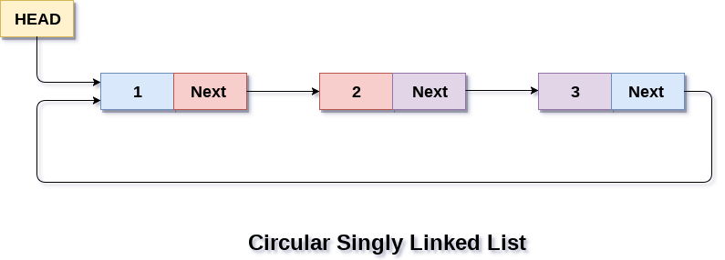
we can overcome the drawback of of single linked list using circular linked list

Slide 43
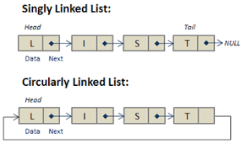
Circular linked list
In a circular linked list, the last node contains a pointer to the first node of the list, which results in traversing continuously.
If we are at a node, then we can go to any node. But in linear linked list it is not possible to go to previous node.
It saves time when we have to go to the first node from the last node. It can be done in single step because there is no need to traverse the in between nodes.
Going to starting node from node takes only less time where as it is difficult in single linked list

Slide 44
Dis-Advantages of circular linked lists
Even though it overcome drawbacks of single linked list, circular linked lists also having following disadvantages:
It is not easy to reverse the linked list.
If proper care is not taken, then the problem of infinite loop can occur.
If we at a node and go back to the previous node, then we can not do it in single step. Instead we have to complete the entire circle by going through the in between nodes and then we will reach the required node.
No direct accessing of elements.

Slide 45
DOUBLE LINKED LIST
To overcome the drawback of SLL and CLL , we move for DLL i.e., Going back to the previous node can not be done in a single step.
Concept:
In double linked list each node contains two pointers, the one pointer points to the previous node and another points to the next node in the list.
A double linked list is a two-way list because one can move in either from left to right or from right to left

Slide 46
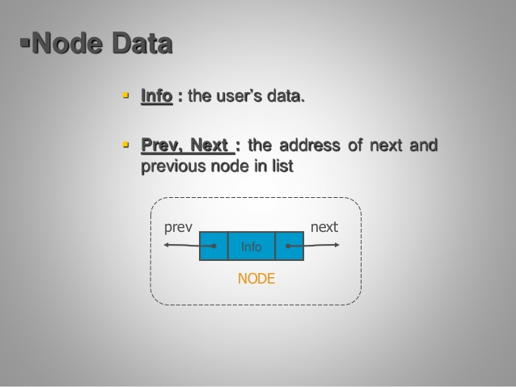
Representation

Slide 47
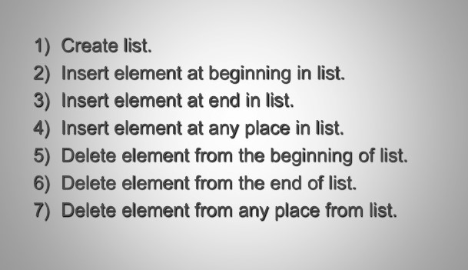
Operations on DLL

Slide 48
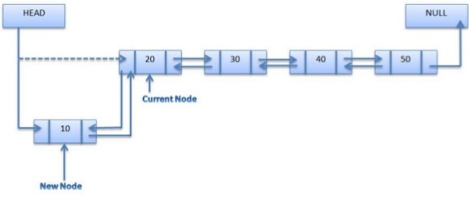
Insert an element at begining DLL

Slide 49
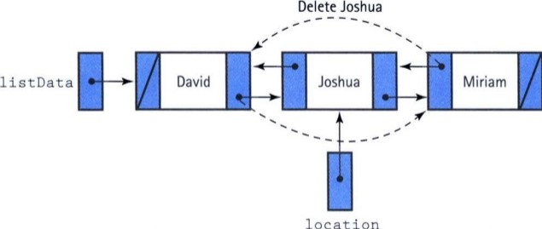
Delete an element at any place DLL

Slide 50
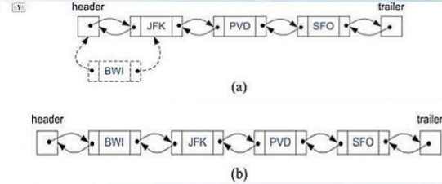
Insertion
Adding element at front (a).During
(b).After

Slide 51
Advantages of DLL
1.we can traverse in both directions i.e from starting to end & as well as from end to starting.
2.It is easy to reversethe linked list.
3.If we are at a node then we can we go to any node .but in linear linked list ,it is not possible to reach the previous node.

Slide 52
Disadvantages of DLL
It requires more space per node because one extra field is required for pointer to previous node
Insertion & deletion take more time than linear linked list because more pointer operations are required than linear linked list

Slide 53
DOUBLE Circular linked LIST
To overcome the drawback of DLL we move for DCLL.
Concept:
In double circular linked list each node contains two pointers, the one pointer points to the previous node and another points to the next node in the list.
In DCLL, the first node of previous pointer points to last node and last node of next pointer points to first node.
For more about DCLL refer class notes.

Slide 54
Queries???
(jayakrishna@rguktsklm.ac.in)

